Slide 1
My wallet Application

Slide 2
Introduction
My Wallet is a comprehensive application that empowers users to manage expenses, track spending, and create flexible budgets effortlessly. Leveraging advanced Machine Learning (ML) techniques, it automatically categorizes payments for efficient organization. With features such as goal-setting, timely notifications, and consolidated financial data, My Wallet ensures users stay on track with their budget plans. Take control of your finances and achieve your financial aspirations with My Wallet.
DIGITAL WALLET

Slide 3
Project objectives
01
02
Comprehensive income and expense tracking: Enable users to efficiently manage transactions, access them promptly, and apply filters based on specific periods.
Expense categorisation: Empower users with the ability to categorise their expenses for improved comprehension and effective budget management.
03
04
Customisable notifications: Alert users about upcoming payments, rising expenditures, or any missed updates to financial information.
Goal-setting capabilities: Allow users to establish and work towards financial targets, such as saving $100 per week.

Slide 4
Project objectives
05
06
Enhanced security: Strengthen the application's security measures to protect user data better.
Improved efficiency and user experience: Optimise the application to be more efficient, user friendly, and intuitive.
07
08
Streamlined data management: Simplify data input and interpretation for users, making it easy to manage and comprehend their financial information.
Focus on customer satisfaction: Prioritise user needs and preferences to ensure high satisfaction with the application.

Slide 5
Methodology
The most appropriate SDLC model for this project is the iterative model, as it does not require a complete specification of requirements from the start.
Instead, the software is developed by specifying and implementing a part of it as quickly as possible, then reviewing and identifying further requirements. This process is repeated for each iteration of the model, incorporating customer feedback to develop subsequent versions

Slide 6
Project Requirements:
Software Requirements:
Operating System
Programming Language
Development Framework
Database
Machine Learning Libraries
Notification Service
Hardware Requirements:
Processor
Memory
Storage

Slide 7
Project Requirements:
Functional Requirements:
User Registration
Expense Tracking:
Expense Categorization
Budget Management
Notifications
Goal Setting
Investment Tracking
Multi-Currency Support
Reporting and Analytics
Security
User Interface

Slide 8
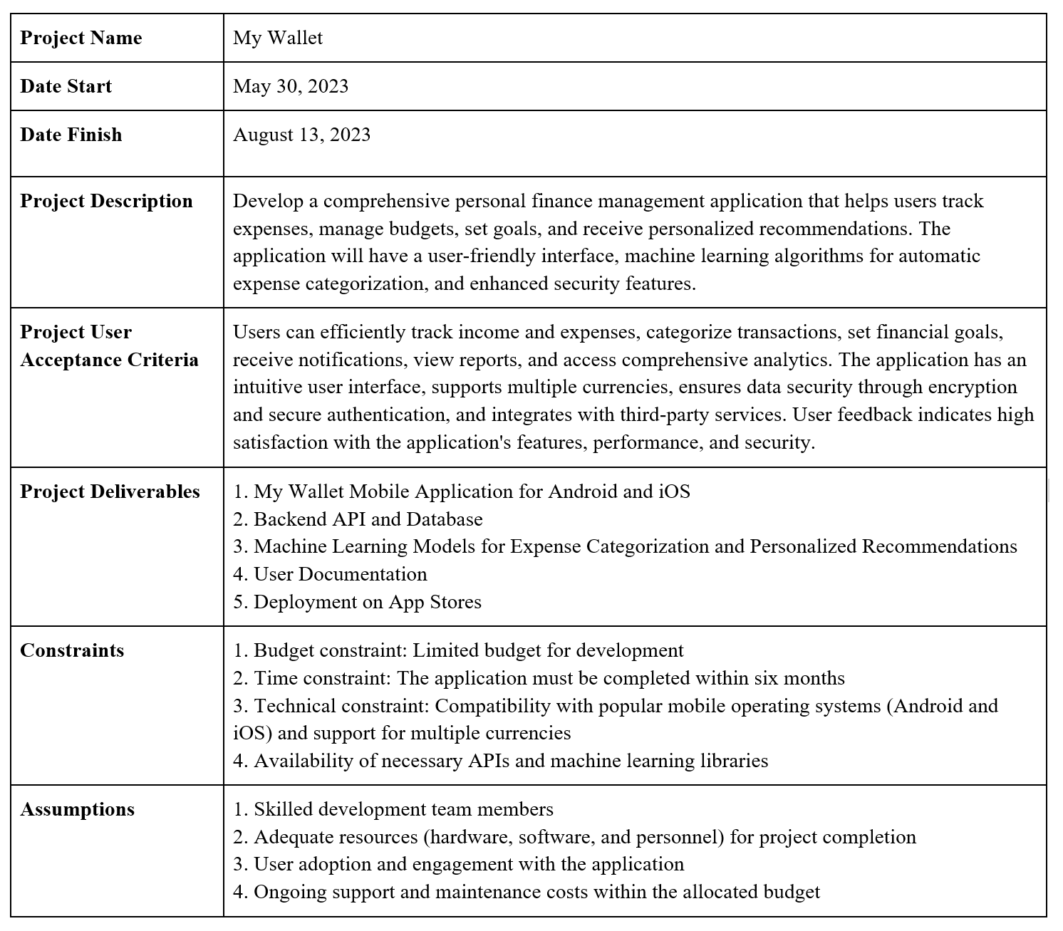
Scope Statement:

Slide 9
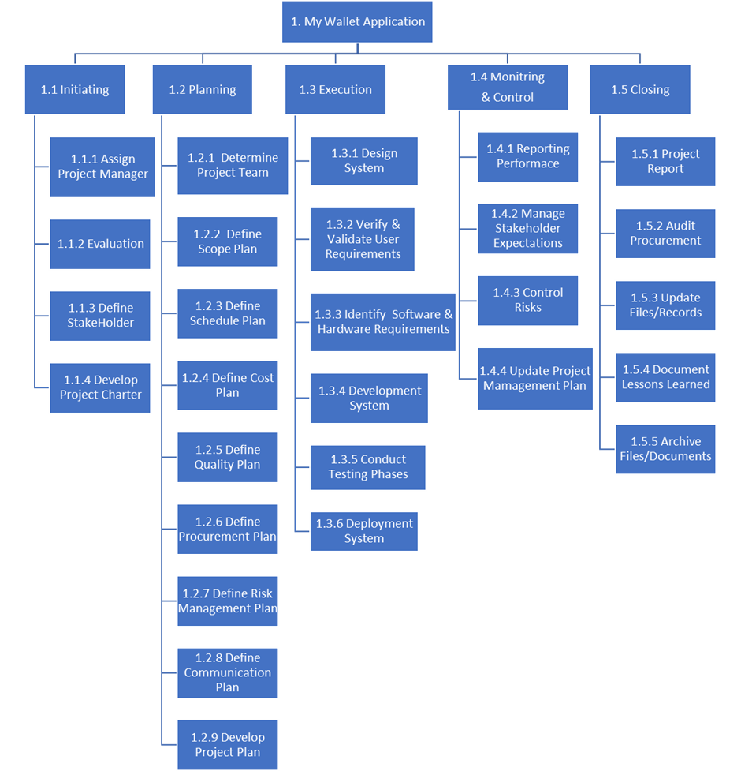
Work Breakdown Structure

Slide 10
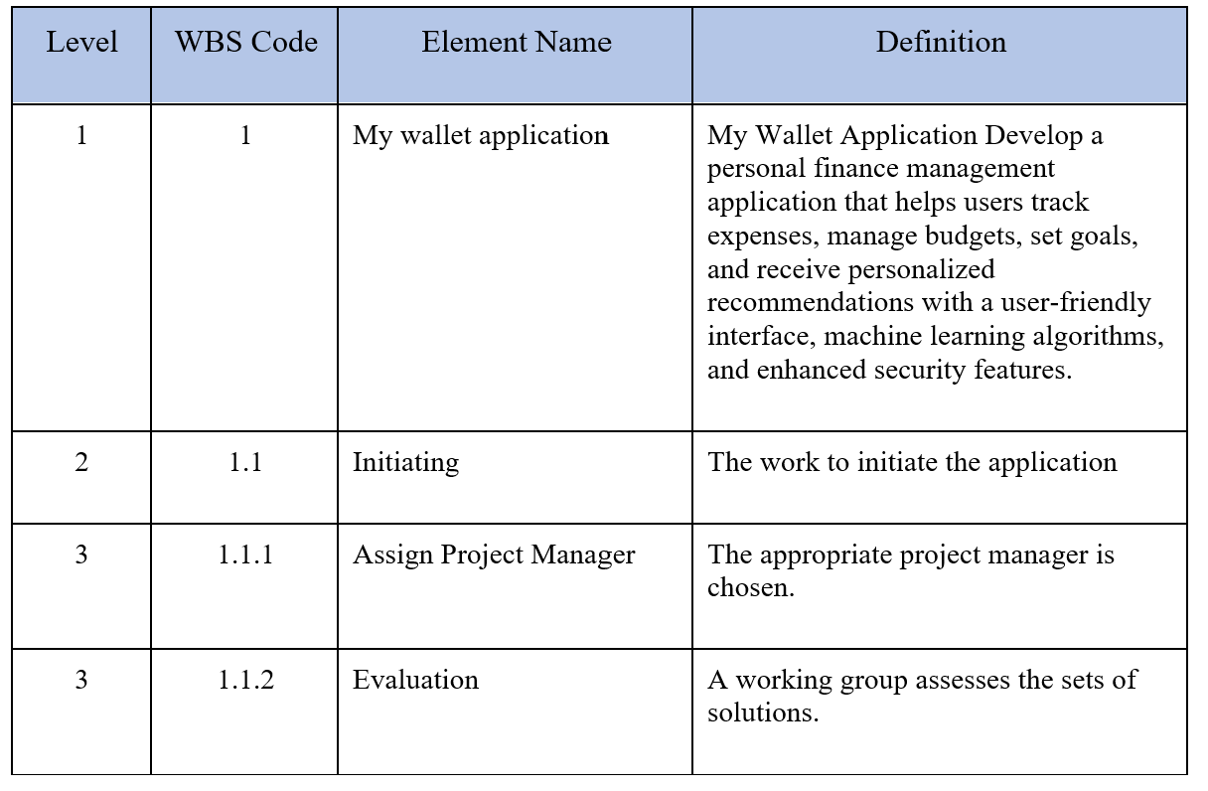
WBS Dictionary

Slide 11
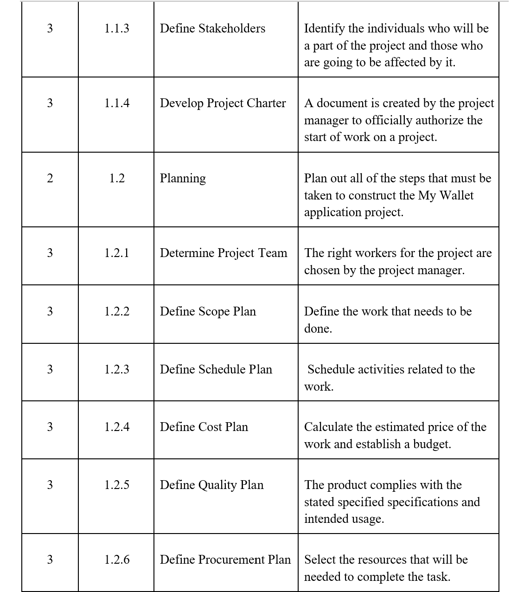
WBS Dictionary

Slide 12
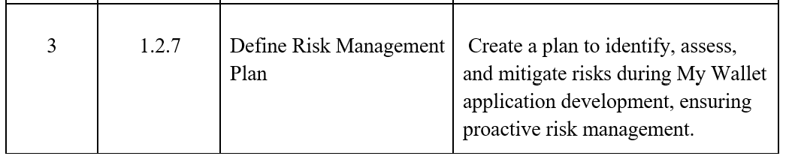
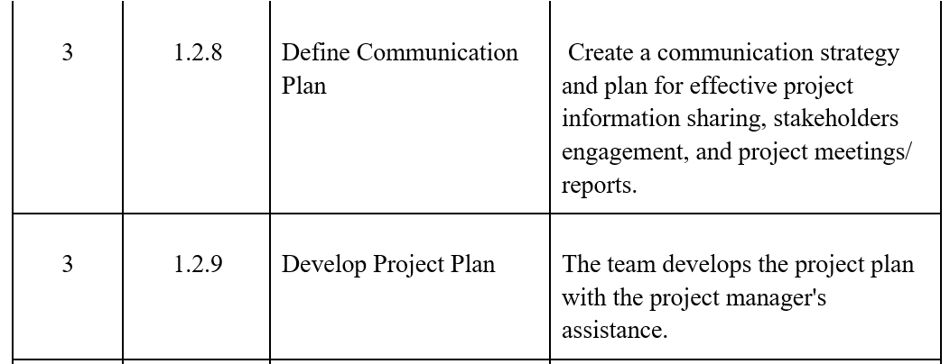
WBS Dictionary

Slide 13
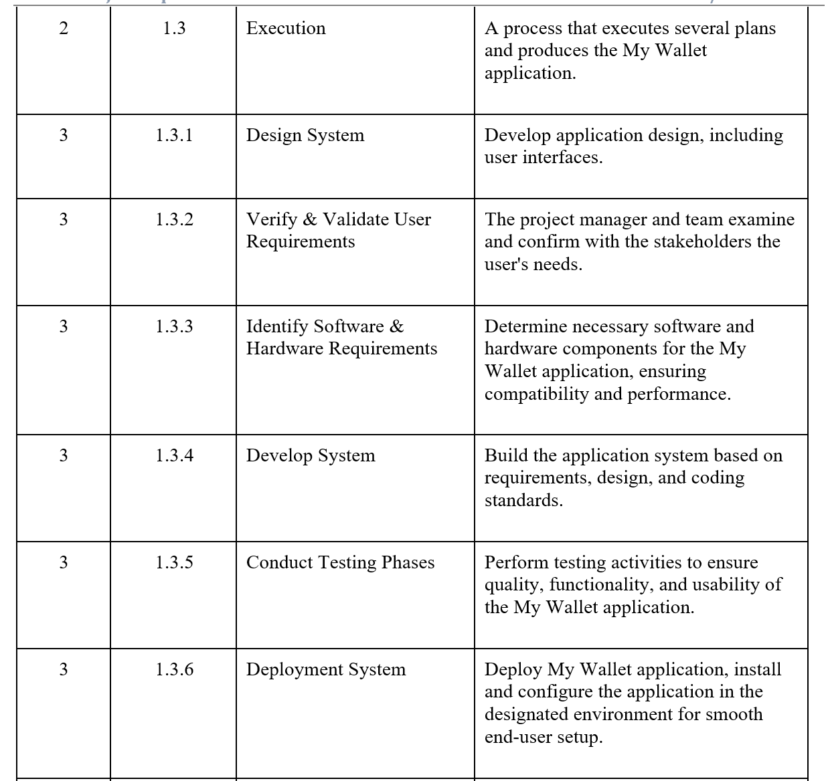
WBS Dictionary

Slide 14
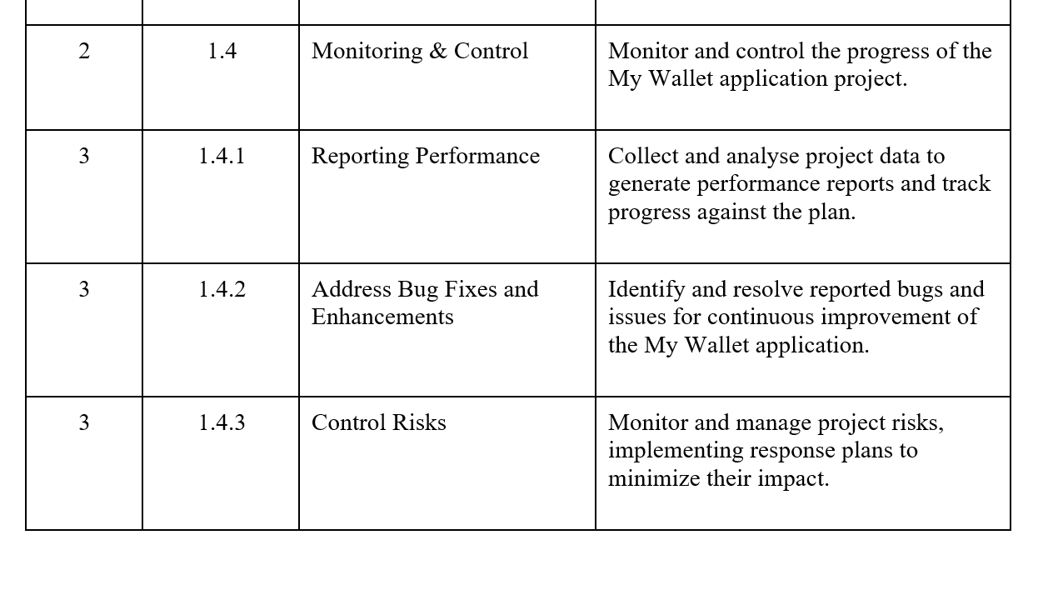
WBS Dictionary

Slide 15
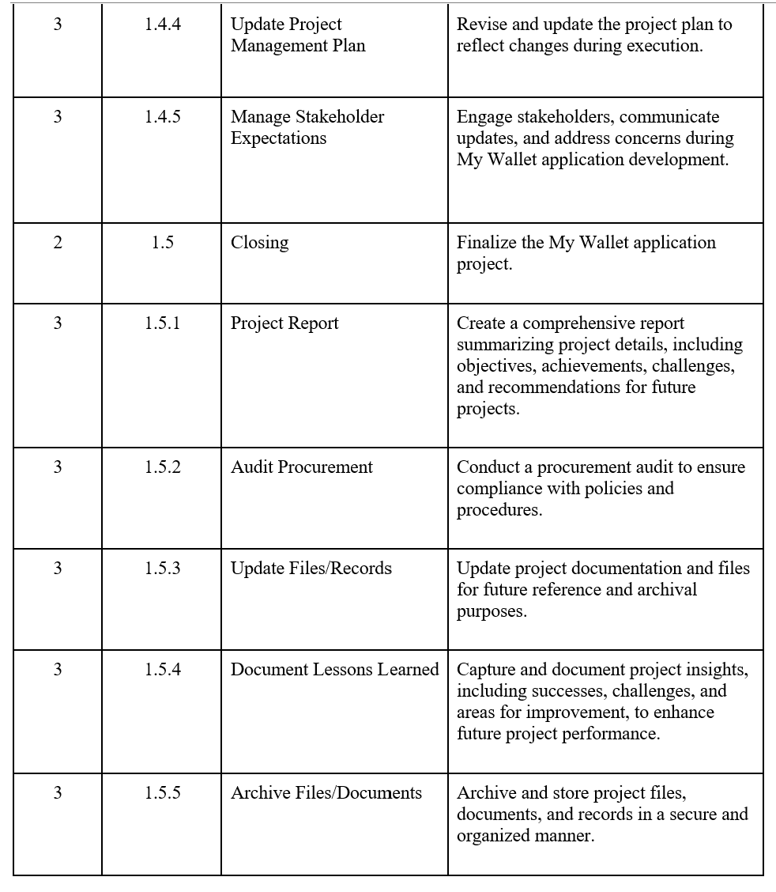
WBS Dictionary

Slide 16
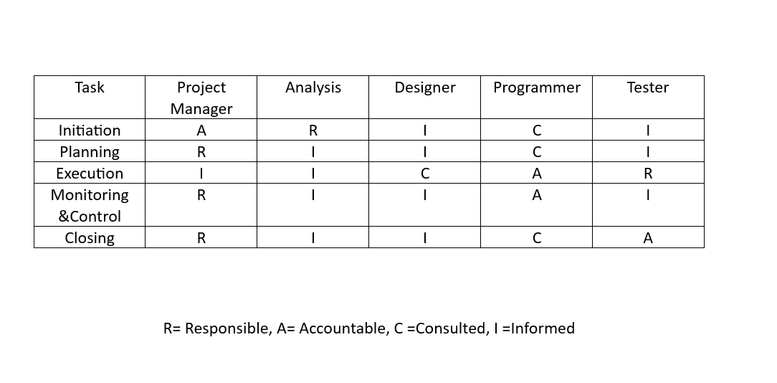
RACI Chart
DIGITAL WALLET
$$$$

Slide 17
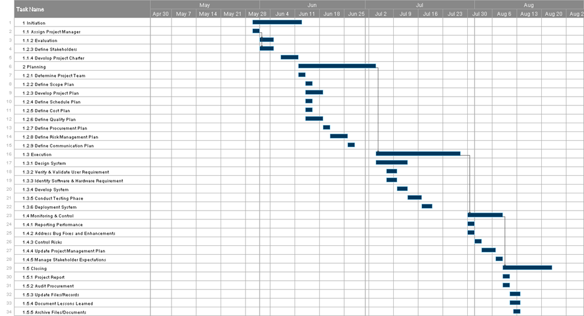
Gantt Chart

Slide 18
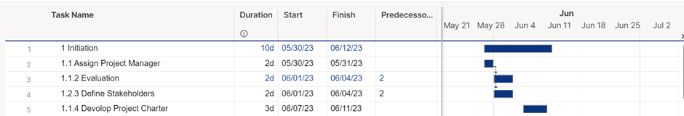
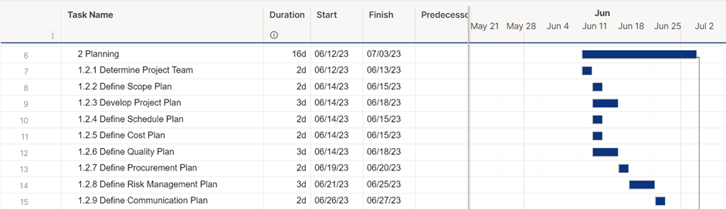
Gantt Chart

Slide 19
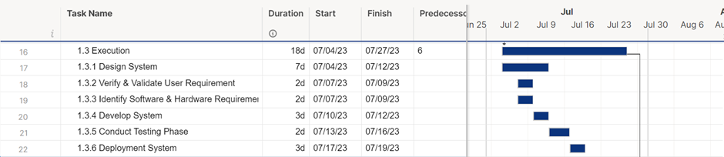
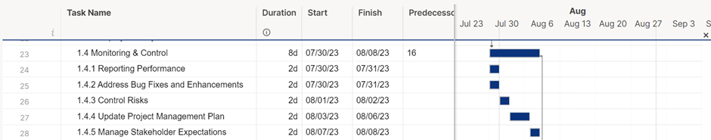
Gantt Chart

Slide 20
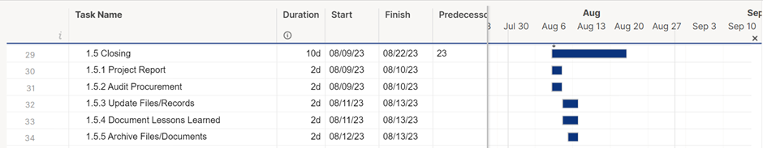
Gantt Chart

Slide 21
References
[1]
Kazakevich, “AI and ML in Financial Planning Apps: Applications, Cost, and Case Studies,” 2019. [Online]. Available: https://hqsoftwarelab.com/blog/ai-and-ml-in-financial-planning-apps/#applications.
[2]
“Iterative Model: Advantages, Disadvantages, and When to Use it,,” [Online]. Available: https://www.professionalqa.com/iterative-model..
[3]
“Work Breakdown Structure,” [Online]. Available: https://www.workbreakdownstructure.com/.
[4]
“smartsheet,” [Online]. Available: https://www.smartsheet.com/.

Slide 22
Thanks !
Do you have any questions?
Group Members :
Monerah Almobarak
Sarah Aljuhani
Sarah Altaweel
Nada Alotaibi

